Slide 1





FLOPPY DISK
PUP
FITNESS
CALENDAR
JANUARY 25, 2025
VERSION 1.1

Slide 2
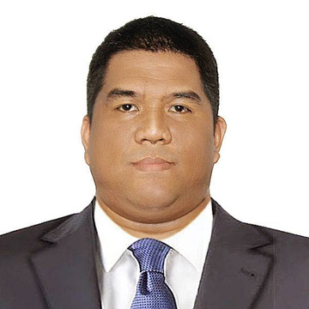
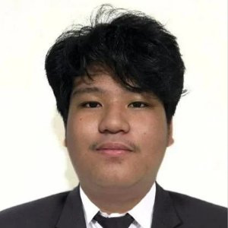
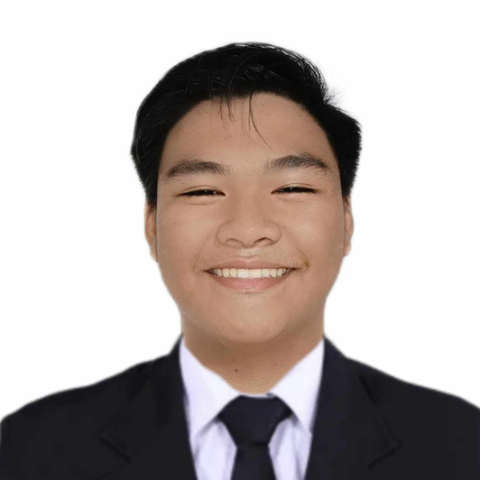

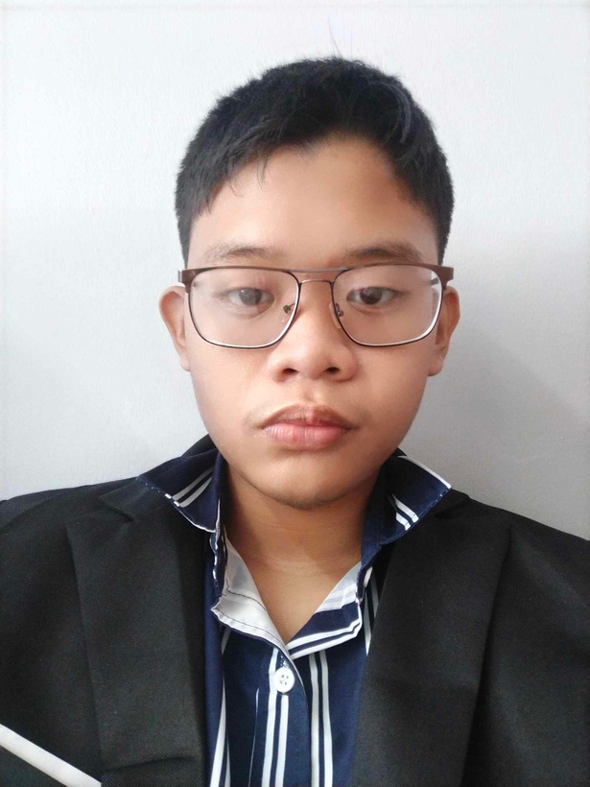
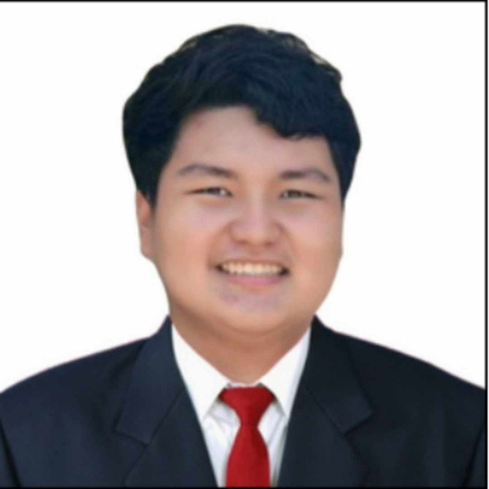
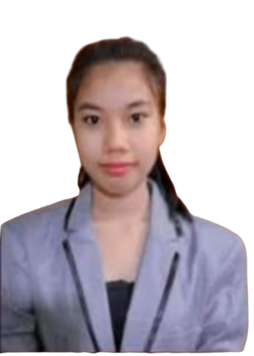

FLOPPY DISK
OUR TEAM
OUR TEAM
GIREMIE MARTINEZ
JOHN ANDREI RIVERA
GIOVANNI C. BRASUELA JR.
LESTER CORTEZ
TEAM LEADER
PROJECT MANAGER
DEVELOPER
DEVELOPER
JOHN EDUARD MABUNGA
BRYANT RODRIGUEZ
JOAN MAE CORBES
QUALITY ASSURANCE
QUALITY ASSURANCE
WILDCARD

Slide 3





FLOPPY DISK
PROB
LEM
1
Lower user engagement with scheduled exercise.
2
Complexity in scheduling and managing exercise.
3
Unavailable Youtube Links for workouts

Slide 4



FLOPPY DISK
SOLU
TION
Personalized Reminders
1
Simplify the Interface.
2
Back-up Links
3

Slide 5


overview of the system
FLOPPY DISK
SYSTEM FLOW CHART
BODY MASS INDEX
START
LOG IN
ABOUT
REGISTER
NORMAL MODE,
LIGHT MODE,
DARK MODE
INPUT
(If not registered)
MENU
DISPLAY SETTING
LOG OUT
FITNESS CALENDAR
ACCOUNT SETTING

Slide 6
EPIC/USER STORIES WITH ACCEPTANCE CRITERIA
FLOPPY DISK
As a student...
Logging In
I want to register using my PUP credentials (webmail)
So that my account is securely linked to the university system.
The user must be able to register using their PUP credentials(webmail)
The system validates credentials against the university database
Calendar Usage
I want to explore the calendar layout and see a clear representation of the dates and scheduled exercises.
So that I can understand how to organize and plan my fitness activities.
I want to explore the calendar layout and see a clear representation of the dates and scheduled exercises
A modal or form appears upon selecting a date, allowing the user to input exercise type, duration, and time.
Website Experience
I want to feel that the website is user-friendly, engaging, and tailored to my fitness needs.
So that I am encouraged to return and continue using the platform.
The user must be able to navigate the website easily and complete basic tasks.
Any faulty functions and suggestions should be head and cared for the sake of the users

Slide 7
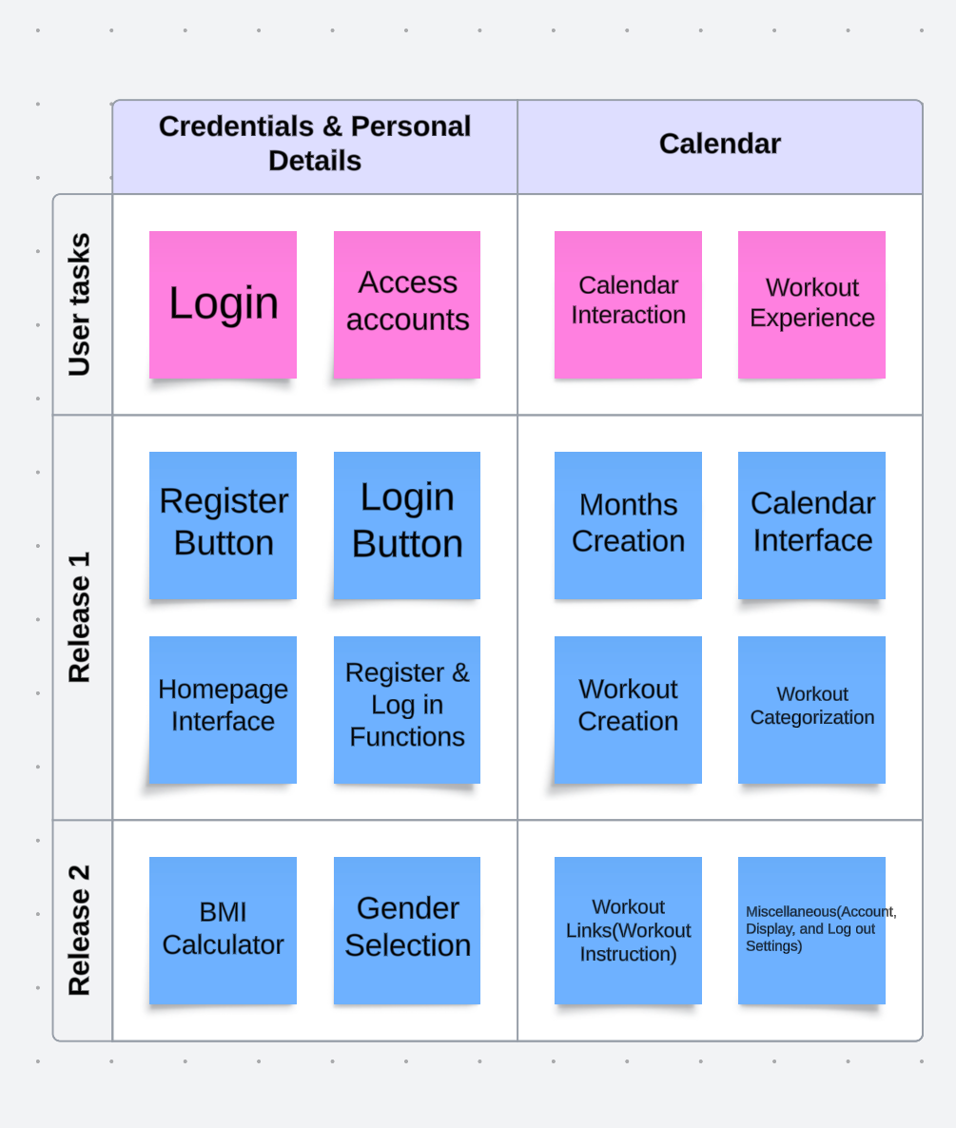
FLOPPY DISK
USER STORY MAPPING

Slide 8
Timeline & milestone
FLOPPY DISK
MILESTONE
Project Plan Finalization
Approved Project Plan
Coding Start
Documentation
MILESTONE
Continuation of Coding
Debugging
Documentation
KEY FUNCTION
DEVELOPMENT
PROJECT
DOCUMENTATION
INITIATION
OF CODING
2024
TEST PLAN
DEBUGGING
FINAL TESTING
NOVEMBER 16 - NOVEMBER 30
DECEMBER 17 - DECEMBER 29
NOVEMBER
PROJECT PLANNING WEEK 1
2ND RELEASE WEEK 3
FEBRUARY
DECEMBER 7 - DECEMBER 14
JANUARY 11 - JANUARY 25
1ST RELEASE WEEK 2
FINALS WEEK 4
BRAINSTORMING
FINAL CONCEPT
EXECUTION OF
TEST PLAN
CODING &
DEBUGGING
2025
PLANNING &
VISUALIZATION
EXECUTION OF
TEST PLAN
MILESTONE
MILESTONE
Application Prototype Completed
Initial application version of codes
Completed Test Plan.
Finalization of codes
Debugging
Final Test run

Slide 9
FLOPPY DISK
Project Management
Gantt Chart
PROCESS
NOVEMBER 16 - NOVEMBER 30
DECEMBER 7 - DECEMBER 14
DECEMBER 17 - DECEMBER 29
JANUARY 11 - JANUARY 25
Planning and
Concept Finalization
Application Development
Test Plan
Run Test

Slide 10
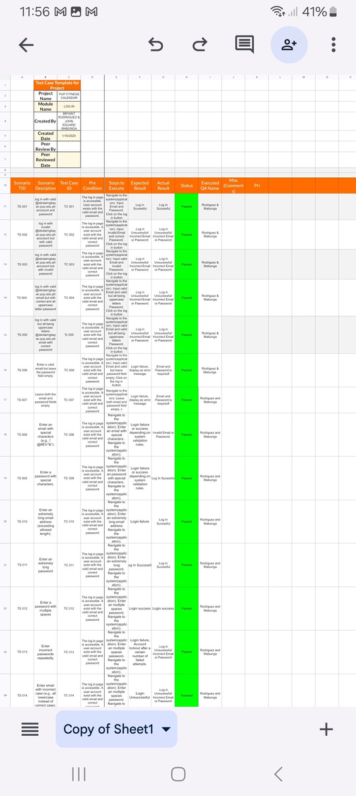
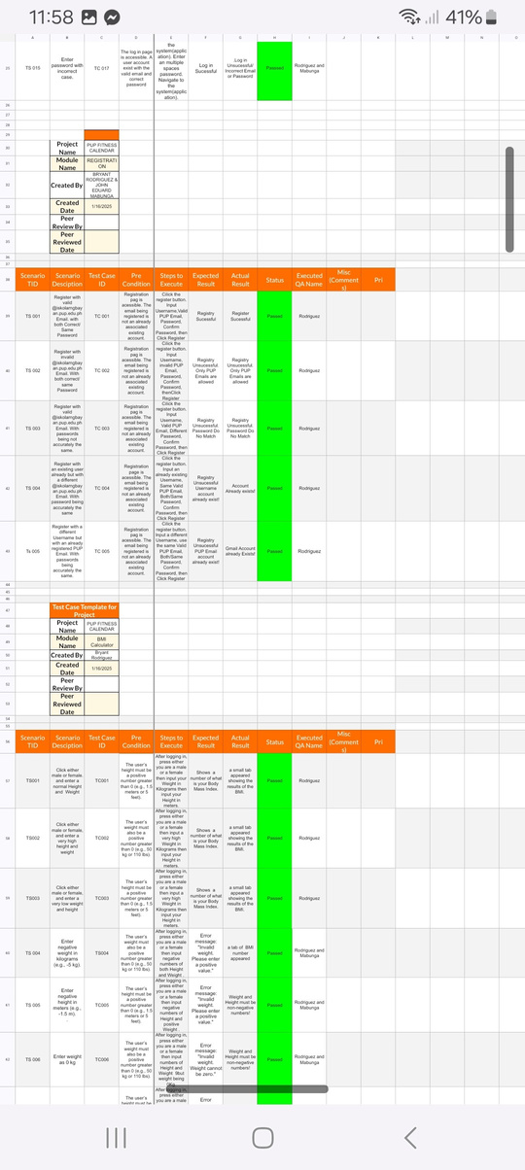
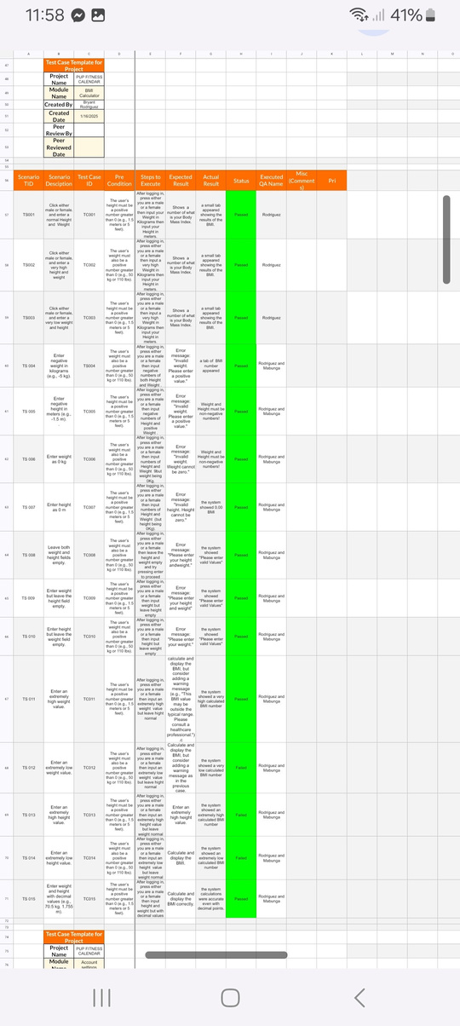
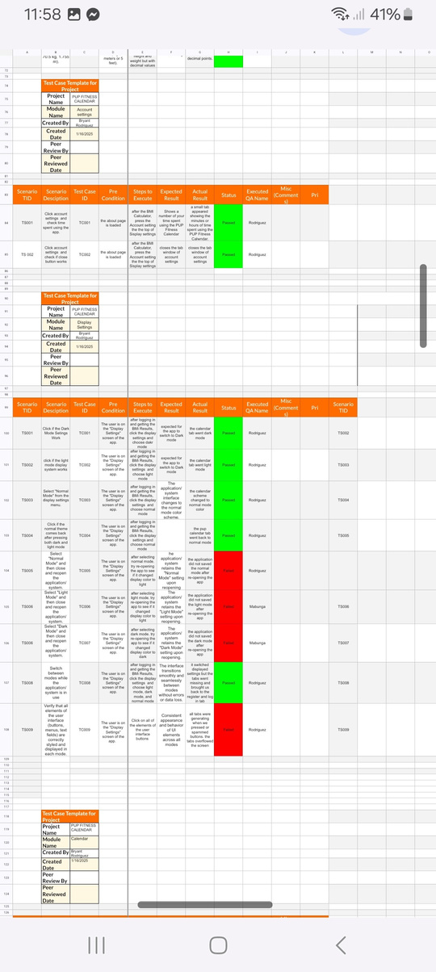
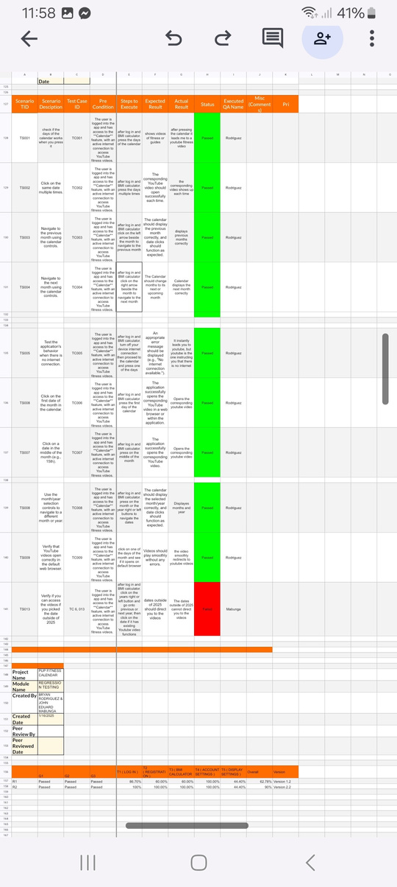
FLOPPY DISK
TEST CASES

Slide 11
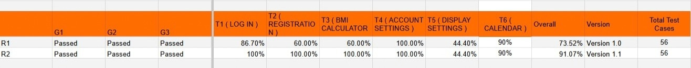
FLOPPY DISK
REGRESSION

Slide 12
STUDIO SHODWE
SUMMARY
CONCLUSION
THE PUP FITNESS CALENDAR IS A PLANNED TIMETABLE CREATED TO ENCOURAGE STUDENTS' PHYSICAL AND MENTAL WELLNESS. THE CALENDAR LISTS DIFFERENT WELLNESS AND FITNESS PROGRAMS RUN BY FLOPPY DISK.

Slide 13
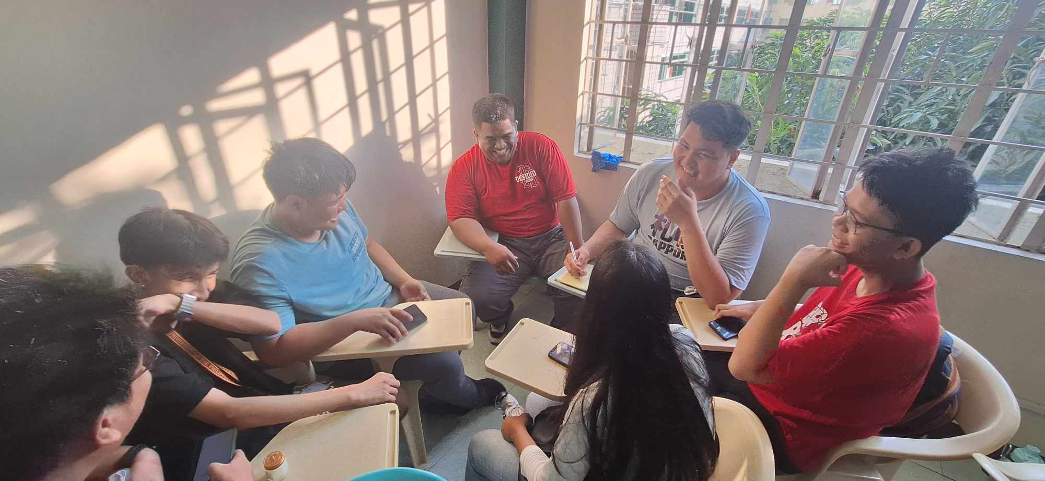
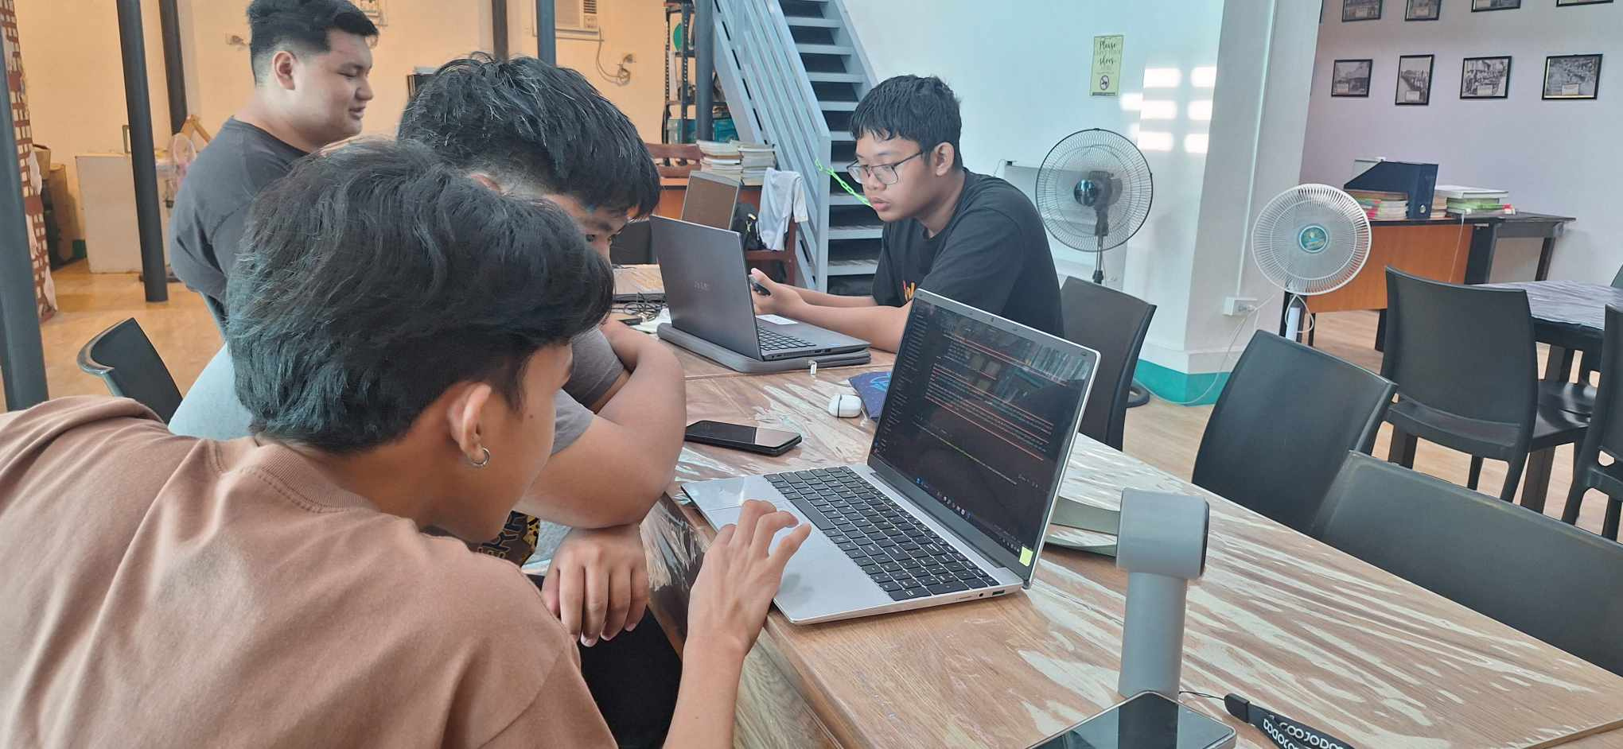
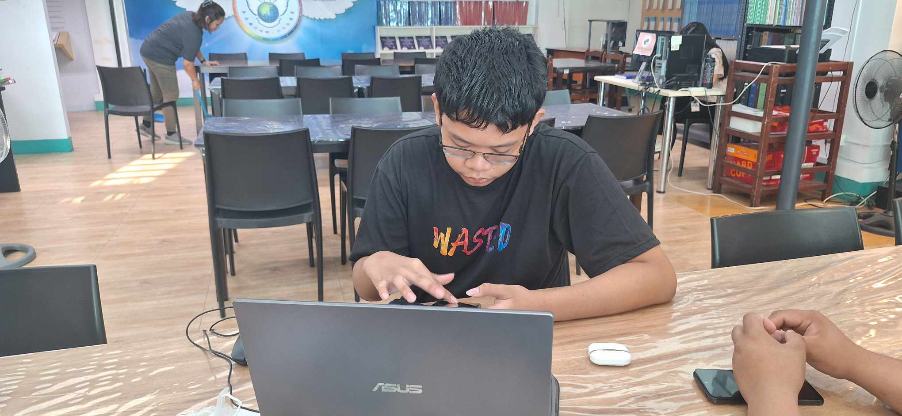
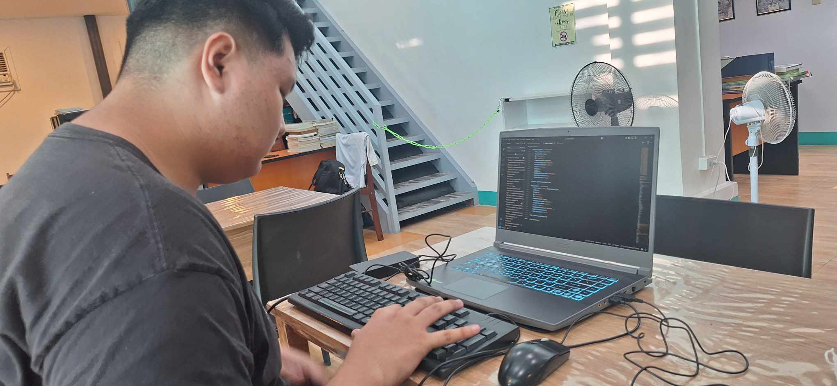
DOCUMENTATION
FLOPPY DISK

Slide 14
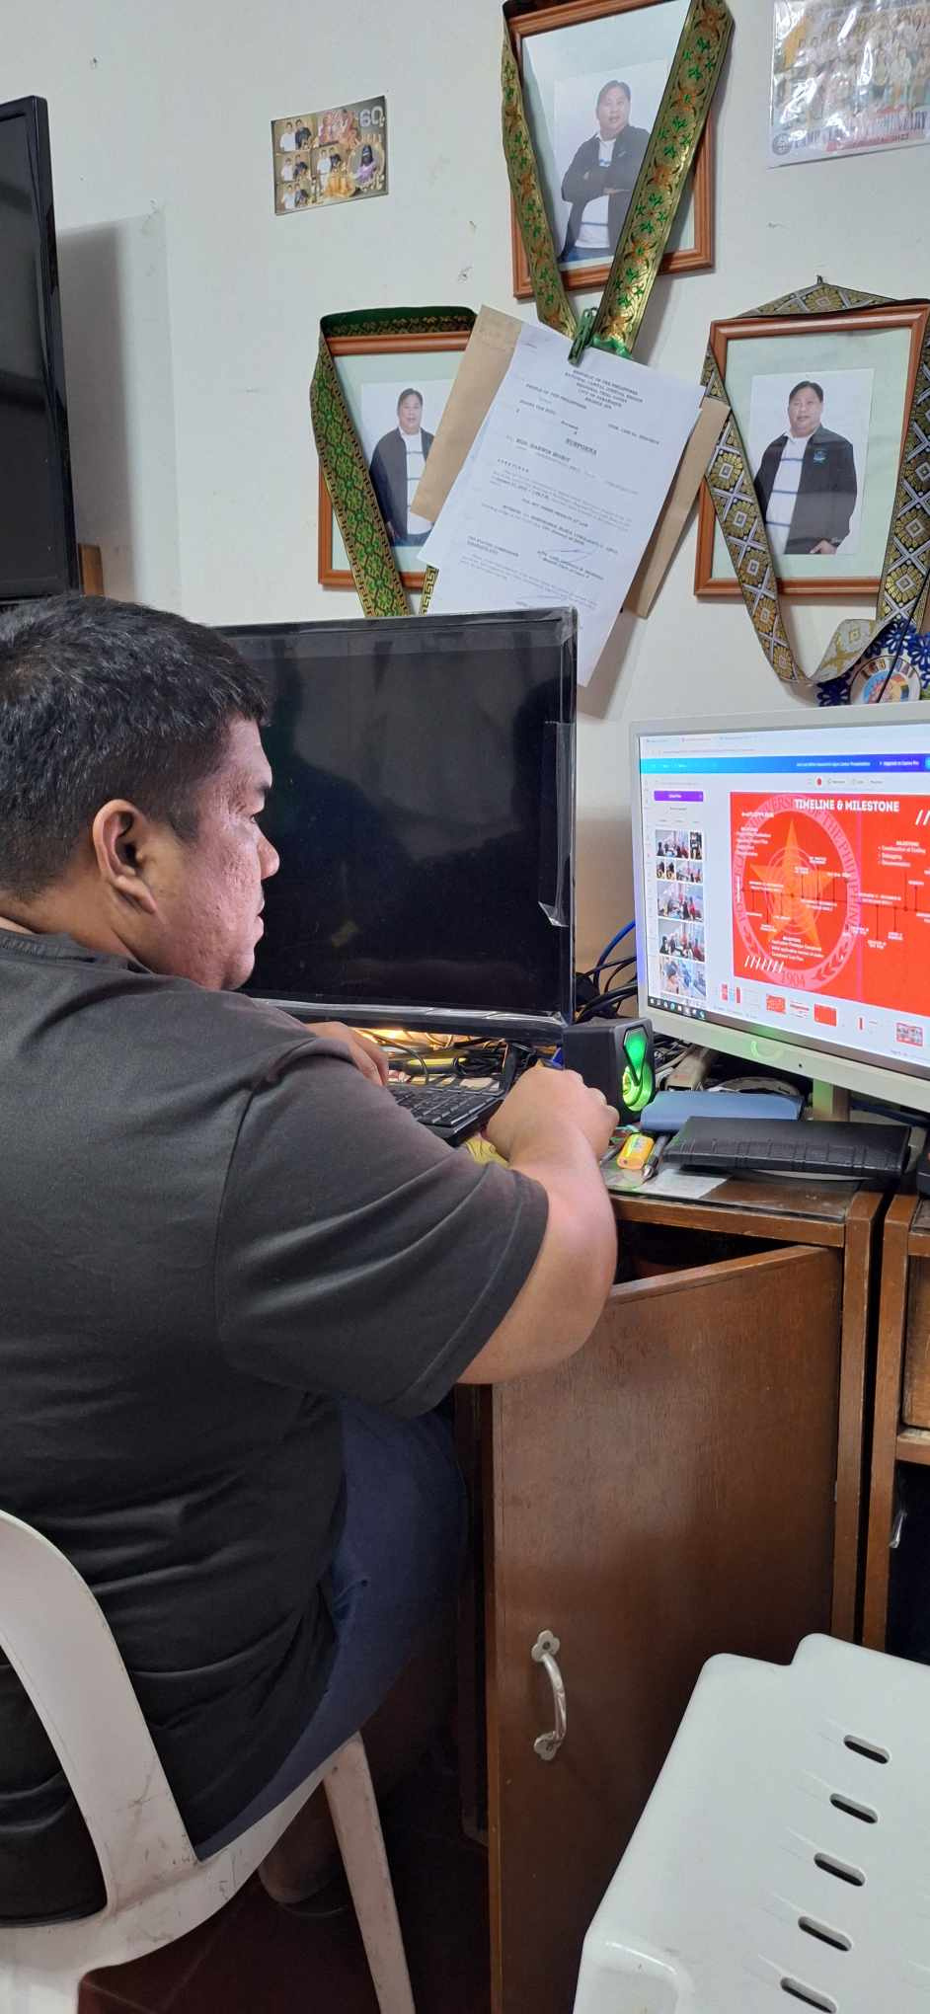
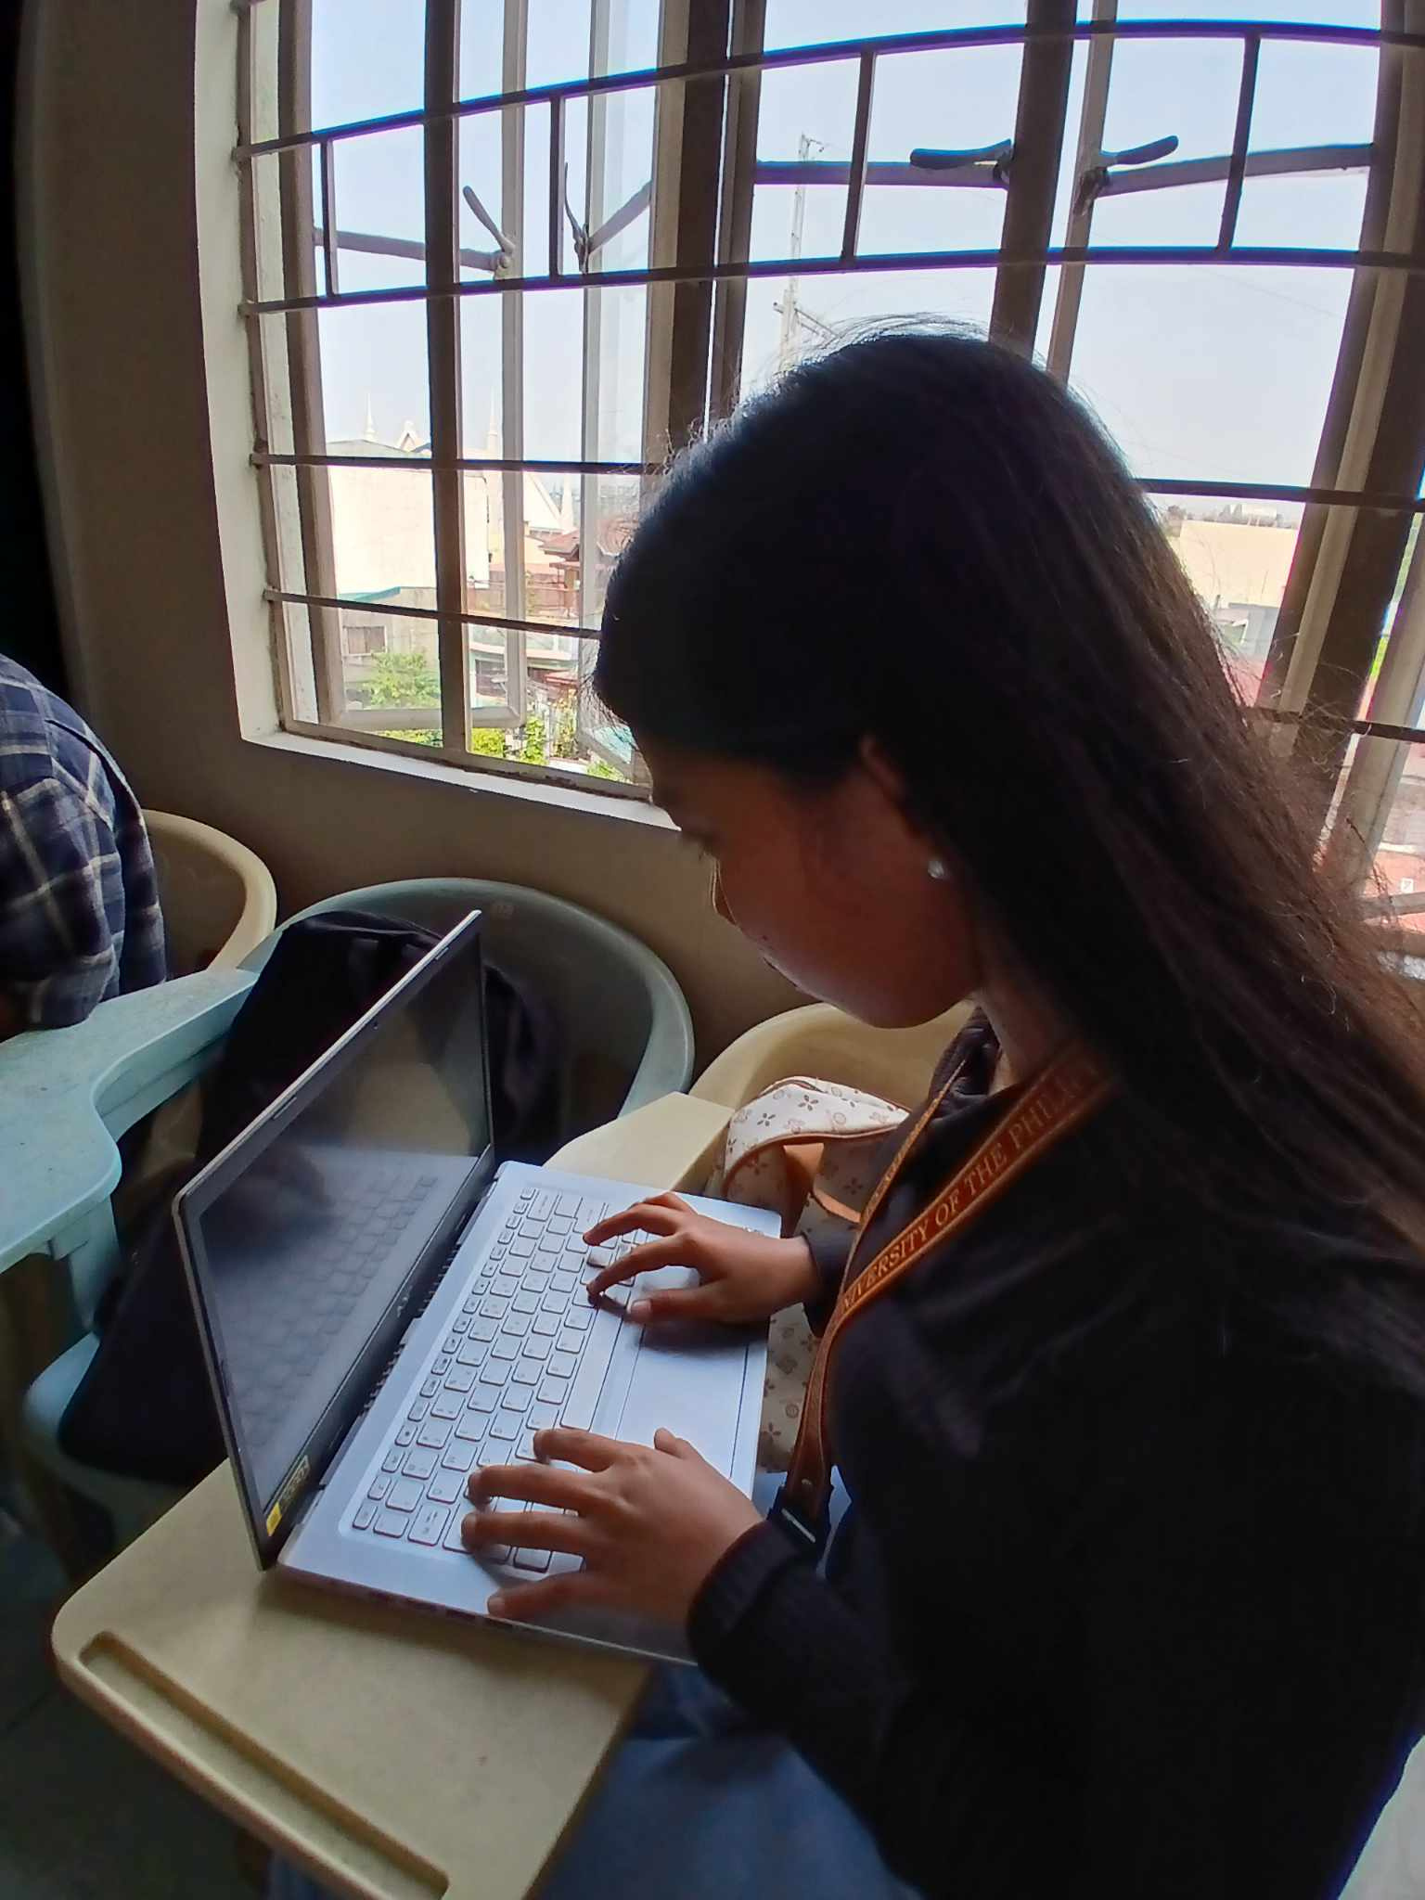
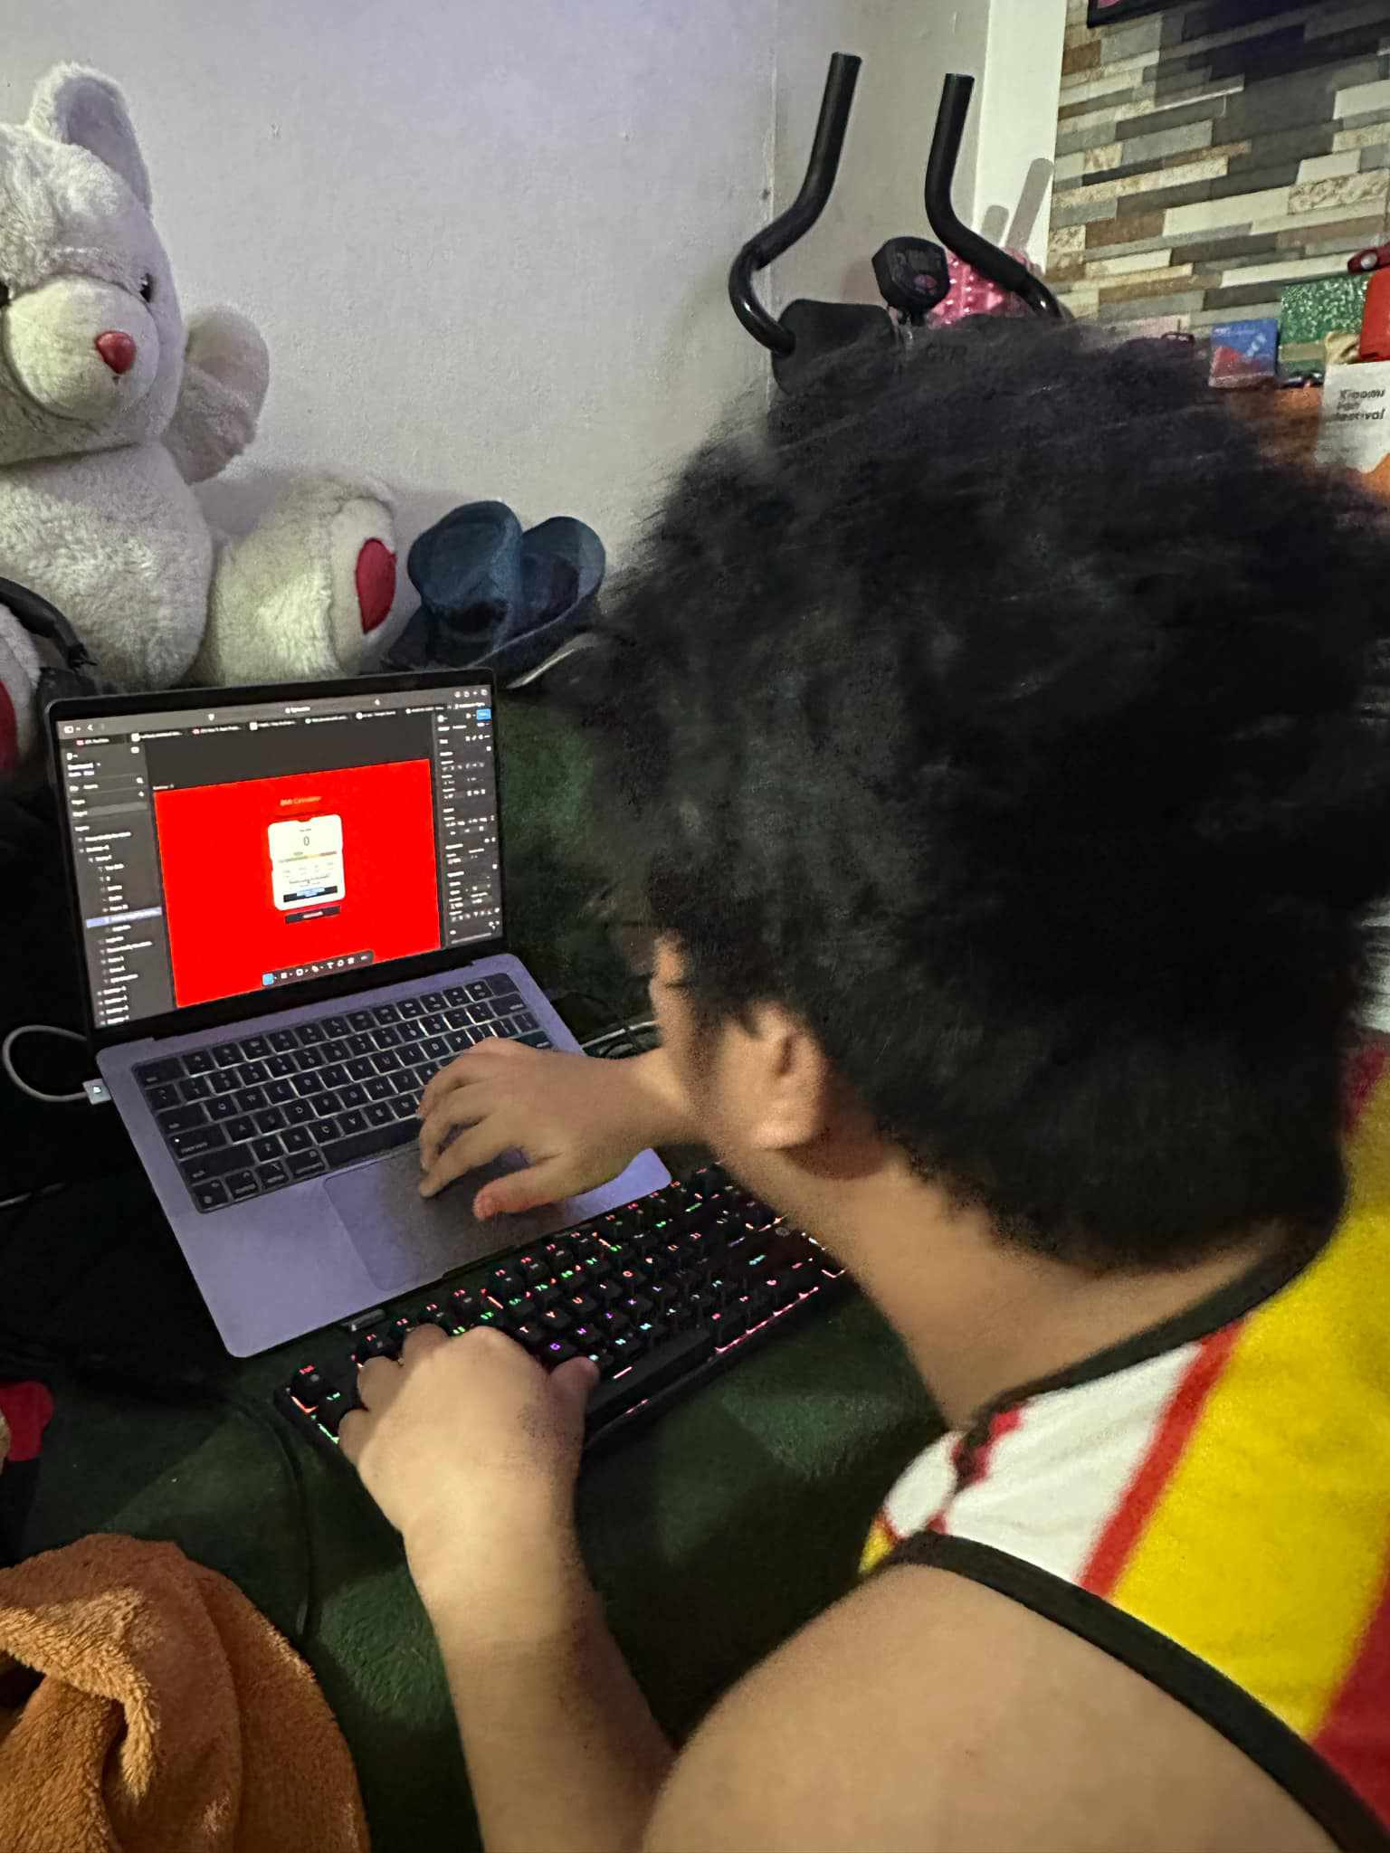
DOCUMENTATION
STUDIO SHODWE

Slide 15
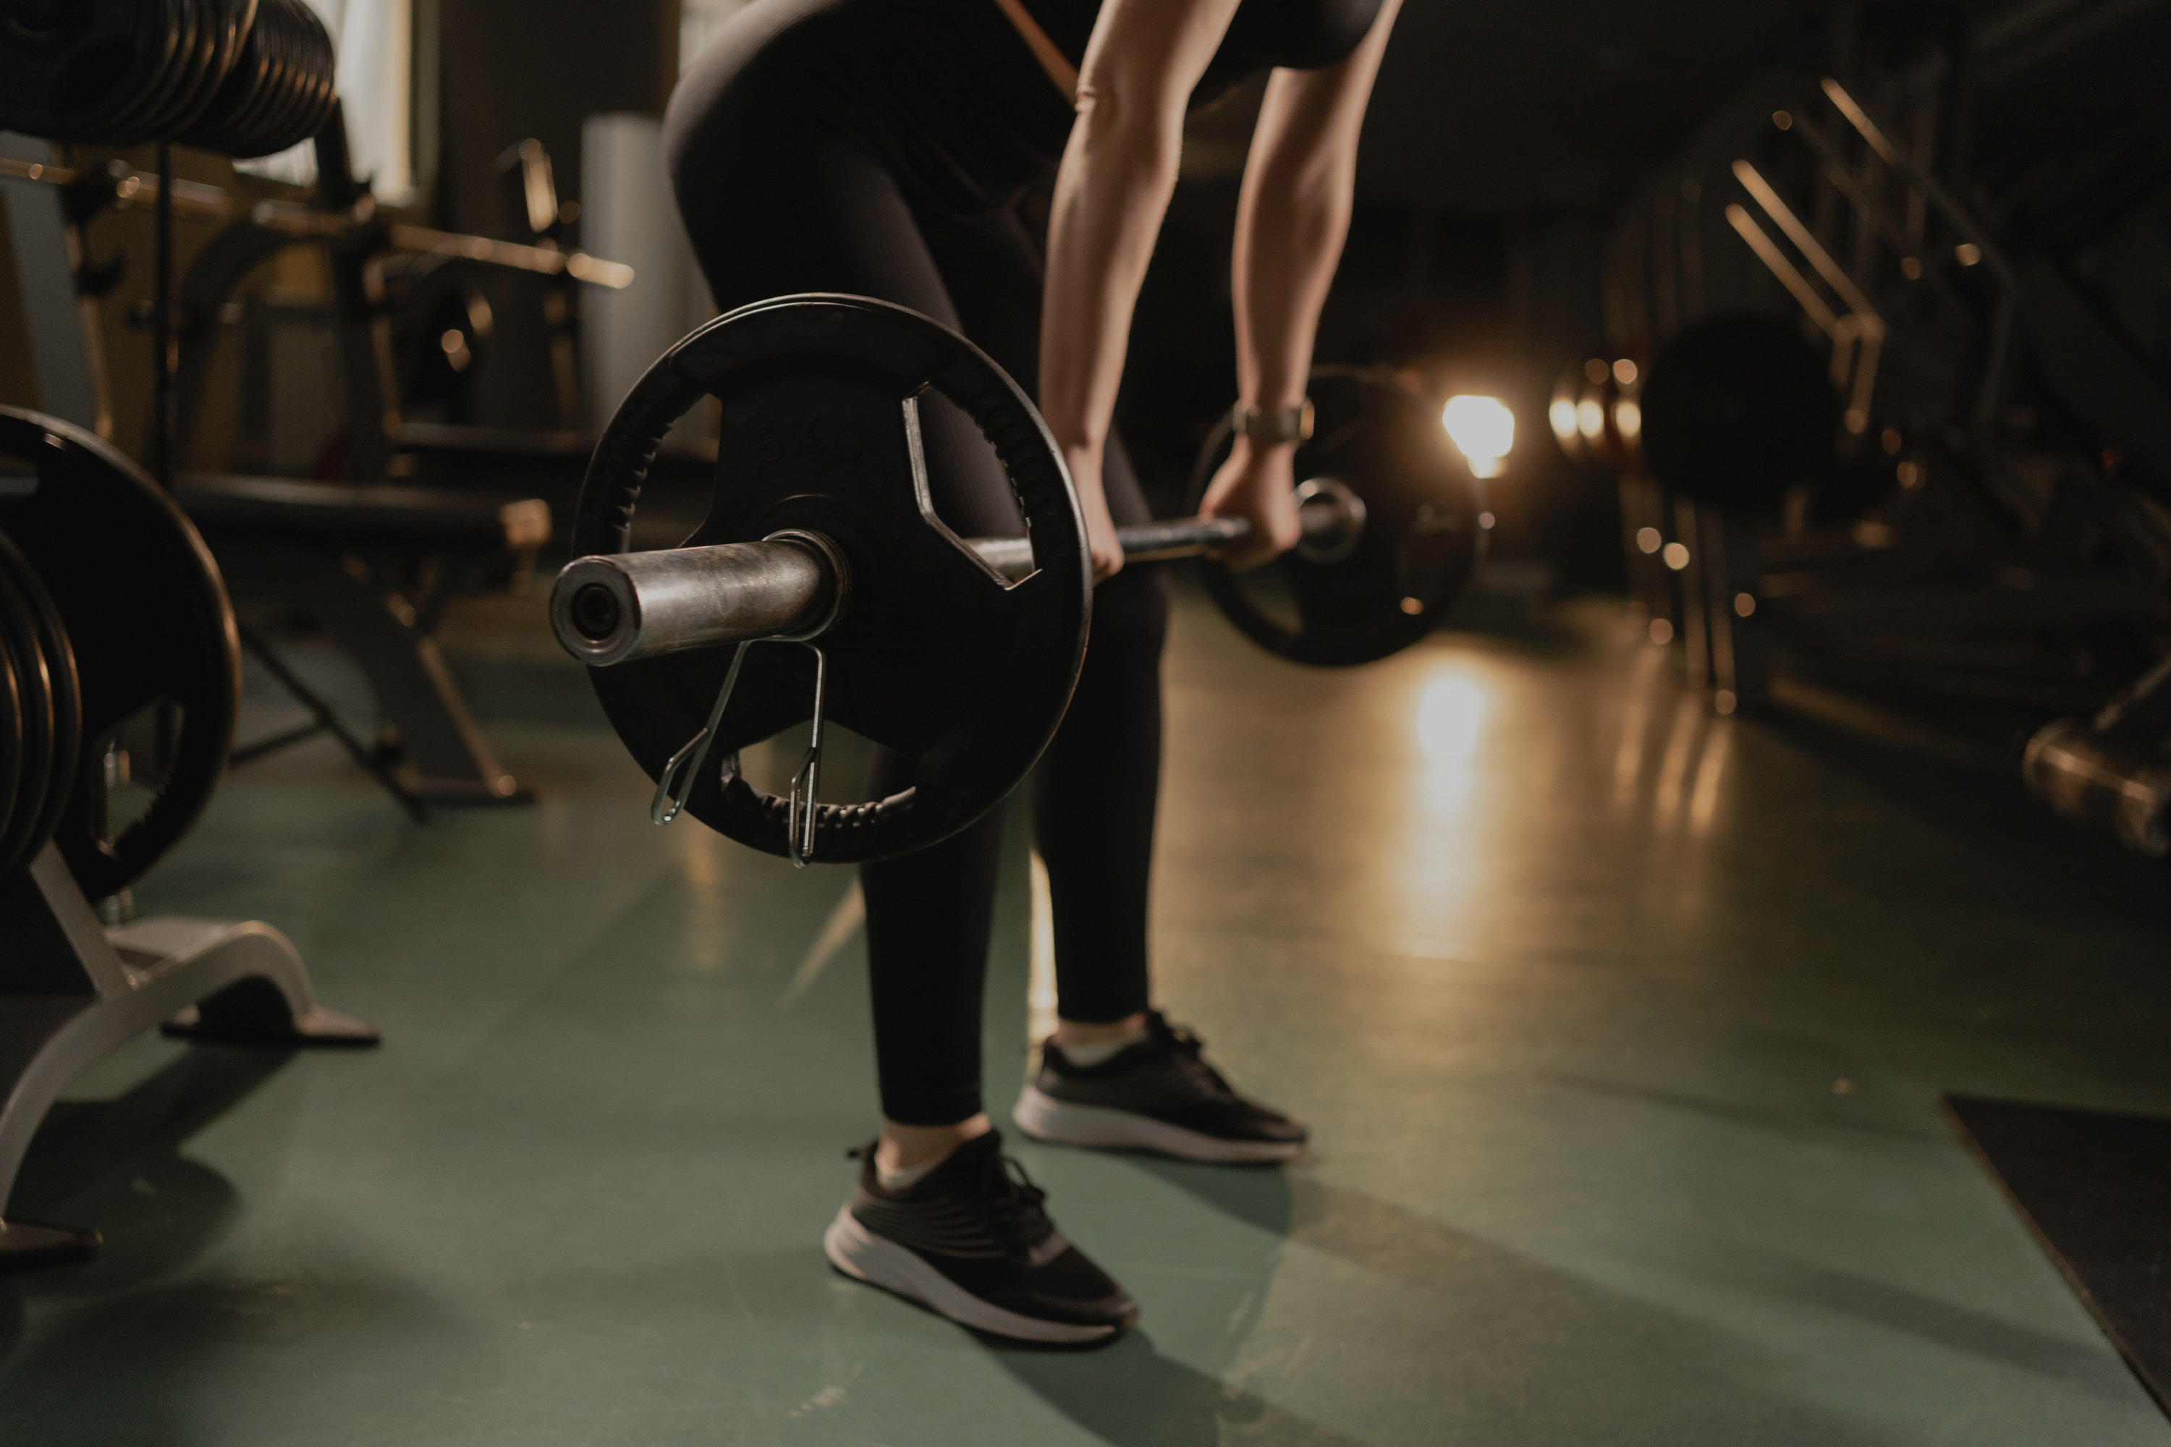
STUDIO SHODWE
THANK
YOU

